Slide 1
DBJ Funding Opportunities for SMEs

Slide 2
MISSION STATEMENT
Provide opportunities to all Jamaicans to improve their quality of life through Development Financing, Capacity Building, Public Private Partnerships & Privatization solutions in keeping with GOJ Policy.

Slide 3
OUR ACHIEVEMENTS
Over the past 3 years:
Loans valued over $20B supporting investments of over J$37.5B to facilitate 14,000 new jobs and maintaining 44,000 jobs
MSMEs: Granted 27,000 loans valued $8B
Energy: Loans valued over $2B to support 220+ Energy Efficiency & Renewable Energy projects
CEF Guarantees of over $469M allowing 185 SMEs to access over $1B in loans

Slide 4
DBJ’s PRIMARY OPERATION
DBJ
FINANCIAL INSTITUTIONS
BUSINESSES/
ENTREPRENEURS

Slide 5
DBJ’s PRIMARY OPERATION
DBJ
FINANCIAL INSTITUTIONS
BUSINESSES/
ENTREPRENEURS

Slide 6
GENERAL CRITERIA FOR DBJ LOANS
Equity Injection: 10% - 30%
Tax compliant
Technically & Financially viable
Positive Contribution to Economy
Registered & operating in Jamaica

Slide 7
STRATEGIC SECTORS
Agriculture
Agro-processing
Energy
Infrastructure
Information Technology
Manufacturing
Mining & Quarrying
Retail & Distribution
Services
Tourism

Slide 8
LOAN PURPOSES
Construction & Expansion of structures
Establishment of Crops & Livestock
To purchase Machinery & Equipment
Energy-Saving Projects
Tourist Attractions & Wellness Projects
Modification of structures
To purchase Movable Fixed Assets
Permanent Working Capital
Exclusions
Purchase of Land/Buildings
Acquisition of Businesses
* Refinance

Slide 9
DEFINITION OF SMEs
ENTERPRISE | ANNUAL TURNOVER | EMPLOYMENT
MICRO | ≤ J$10M | ≤ 5
SMALL | > J$10M ≤ J$50M | 6 - 20
MEDIUM | > J$50M ≤ J$425M | 21 - 50
LARGE | > J$425M | > 50

Slide 10
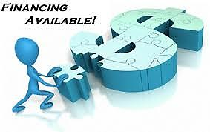
DBJ PROVIDING SUSTAINABLE FINANCIAL SOLUTIONS
SME LOANS
LOANS FOR LARGE BUSINESSES
AGRICULTURAL LOANS
ENERGY LOANS
BUSINESS
RESIDENTIAL
ENERGY AUDIT GRANT
PARITIAL GUARANTEE
CAPACITY DEVELOPMENT ASSISTANCE

Slide 11
SME LOANS
90% financing of Project Cost
Maximum Loan J$30M
Interest Rate at 10% to SME on the reducing balance
Maximum Tenure - 7 Years
Up to 12 months moratorium on Principal
Notes:
Guarantee also available for AFI Loans
Excess of J30 6.5% to AFI; 9.5%to sub-borrower

Slide 12
AGRICULTURAL LOANS
Up to J$8.4M at
Interest rate of 9.5% to client on the reducing balance
Tenure: up to 7 years
Moratorium up to 24 months
90% financing of Project cost

Slide 13
ENERGY SOLUTIONS
Grant of up to J$200,000 for an Energy Audit to SMEs
ENERGY LOANS FOR BUSINESS:
Up to J$30M at 9.5%
Loan Tenure 7 Years
12 Months moratorium on principal
90% financing for SMEs
75% financing for large firms

Slide 14
ENERGY LOANS FOR RESIDENTS
RESIDENTIAL ENERGY LOANS:
Interest Rate -9.5%
Loan Term: 8 years
We finance 90% of Project cost up to J$2M for:
Solar Water Heaters
PV Systems
Wind Turbines
Bio-digester

Slide 15
CREDIT ENHANCEMENT FACILITY (CEF)
ELIGIBILITY CRITERIA:
Annual Sales ≤ $425M
Tax Compliant
Project must be financially viable & technically feasible
Proven Track Record (at least12 months in operation can access $5M and 24 months in operation full coverage of $15M)
Good Credit History
Not for financing of existing loans
PARTIAL GUARANTEE

Slide 16
CREDIT ENHANCEMENT FACILITY (CEF)
DBJ will guarantee:
* 50% of SME loans up to $30M (ie Maximum of $15M)
* 80% of small loans up to $6.25M (ie. Maximum of $5M)
* 80% of Energy loans up to $15M for SMEs
PARTIAL GUARANTEE

Slide 17
CREDIT ENHANCEMENT FACILITY (CEF)
CEF Fees to SME:
* Agricultural Loans: Annual fee of 1% + GCT on the g’tee amount
* All other SME Loans: Annual fee of 2% + GCT on the g’tee amount
PARTIAL GUARANTEE

Slide 18
Voucher for Technical Assistance
Provides assistance to SMEs that need business development services to qualify for a loan.
SME will pay 30% of the service cost
DBJ pays the BDO 70% or the value of the voucher (whichever is lower)
Each SME can access a maximum of 2 vouchers
CAPACITY DEVELOPMENT

Slide 19
Voucher for Technical Assistance
Services Offered:
Business Plan Preparation
Business Process Improvement
Financial Statements
Marketing Plans
Management Consulting Service
Training Courses
CAPACITY DEVELOPMENT
*Value of the Vouchers start at $50,000 up to a maximum of $300,000

Slide 20
How Does It Work?
SME visits a DBJ Accredited Financial Institution (AFI) for a loan to improve/expand business operations
Loan Officer recommends the client for a Voucher and an email is sent to the SME.
SME visits the Business Development organization (BDO) of their choice from DBJ’s approved list:
CAPACITY DEVELOPMENT

Slide 21
How to Redeem a Voucher
SME visits the Business Development organization (BDO) of their choice:
Discuss the service to be accessed
Signs agreement
Pays 30% of the cost
Accesses the service
DBJ pays the BDO 70% or the value of the voucher (whichever is lower)
SME returns to bank if financing is required

Slide 22
Approved Business Development Organisations (BDO)
ABTAX Limited
Boldeck Jamaica Limited
BDO Management Consultants
DGS Chartered Accountants and Business Advisors
Jamaica Business Development Corporation
Jamaica Exporters' Association
University of Technology (UTECH)
CAPACITY DEVELOPMENT
Dynamic Management Strategies Limited
Enterprise Development & Market Access Solutions

Slide 23
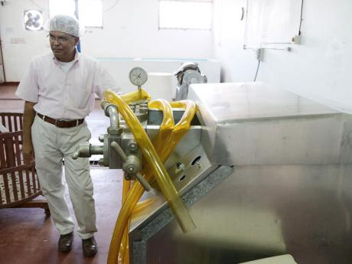
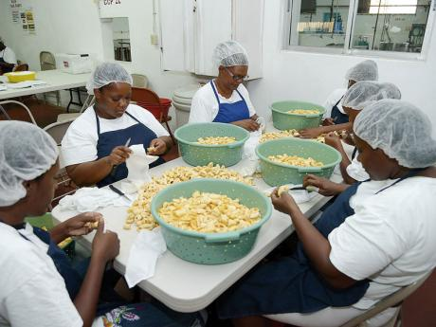
Success Story – Norsai Enterprise Ltd
Business
Agro-processing
Voucher
Financial Statement Voucher
Value - $200,000
Loan
J$30 million
To produce 10,000 cases of products to sell year round
To explore new markets
St. Thomas

Slide 24
QUESTIONS & COMMENTS
Contact Us
Mark McKenzie
Account Executive
Loan Origination & Portfolio Management
Tel: 929-4000 or 409-8548
mmckenzie@dbankjm.com
www.dbankjm.com

